Slide 1
Comparison of Minnesota Governor Candidate Tweets - Fall 2022 Election
Jennifer Edgerton
Ryan Fust
Paul Moretto
Josiah Walter

Slide 2
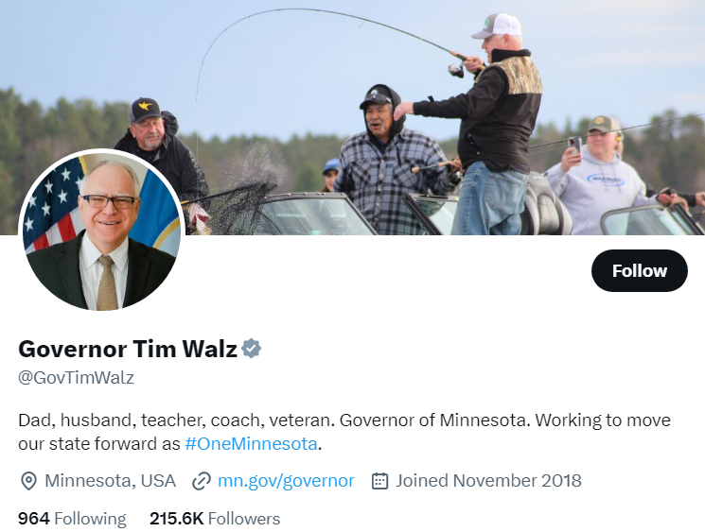
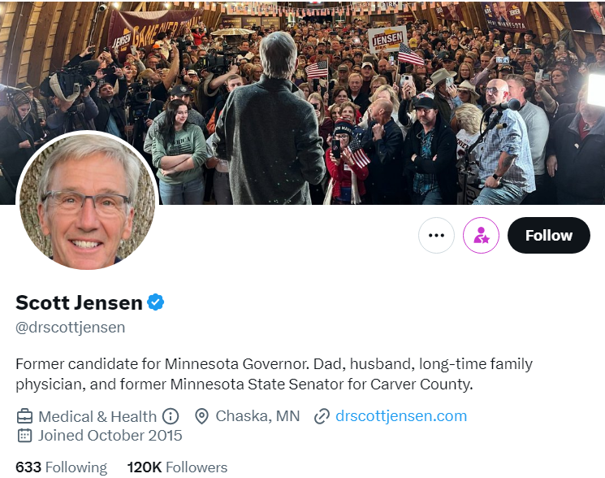
Problem Definition and Understanding: Part I
Problem Statement: There were a significant amount of bots interacting with local politicians during the 2022 Governor Race on Twitter.
Stakeholders: Candidates Tim Walz and Scott Jensen

Slide 3
Data Collection: Part I
As part of the original data collection process, the group used the Twitter API and tweepy library to create an algorithm to obtain usernames of accounts that retweeted selected tweets of Scott Jensen and Tim Walz between July and November of 2022 (API calls limited to 100 to avoid “cooldown”).
These usernames were then passed into the Bot’o’meter API(https://botometer.osome.iu.edu/) and a bot score was generated to identify probable bots. It was at this point the Twitter API was removed from free academic access .
GitHub for data collected, Collab, PDF, csv, etc., https://github.com/PaulAMoretto/TwitterProjectICS412

Slide 4
Data Collection: Part II
The original plan was to collect edge data for the governor retweets. However, due to the change in Twitter API by Elon Musk, this was impossible without a monetary outlay.
Solution: Find a social network dataset, containing comparable networks that had not been used extensively for educational purposes. This dataset is from https://github.com/benedekrozemberczki/GEMSEC/tree/master/data. One dataset is from Facebook politician pages, and the mutual likes between these pages, and the other dataset is from Facebook company pages and the mutual likes between them. Self-edge loops were removed from these edge lists, otherwise this was clean data.

Slide 5
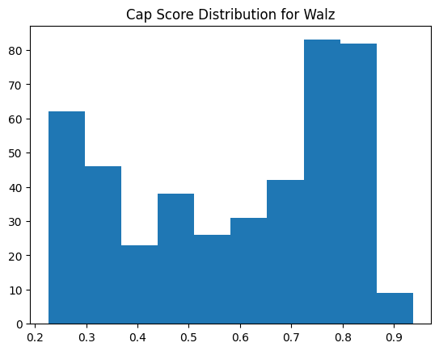
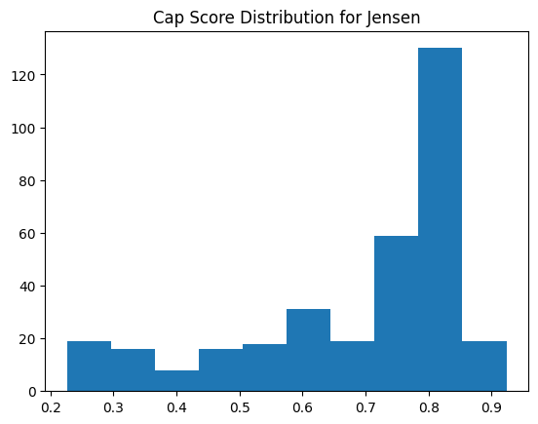
Analysis of CAP score

Slide 6
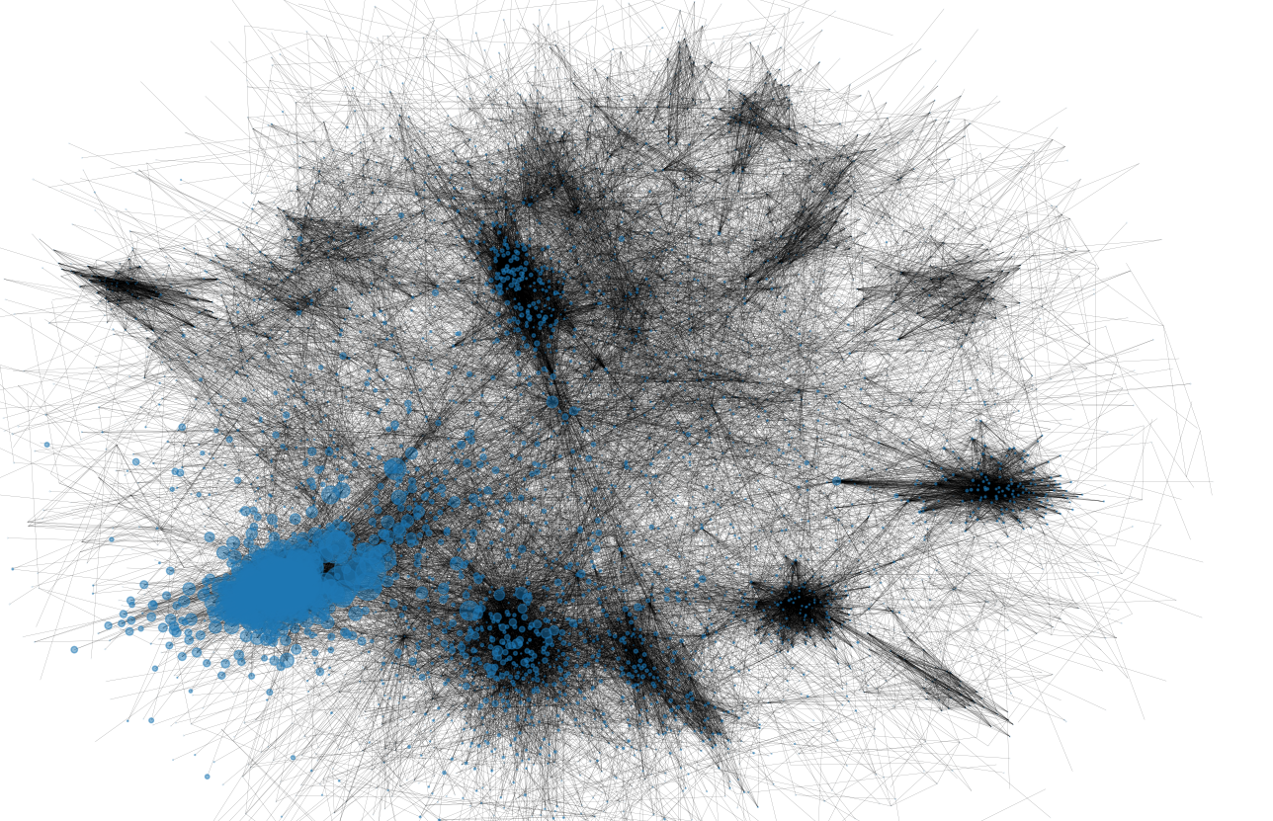
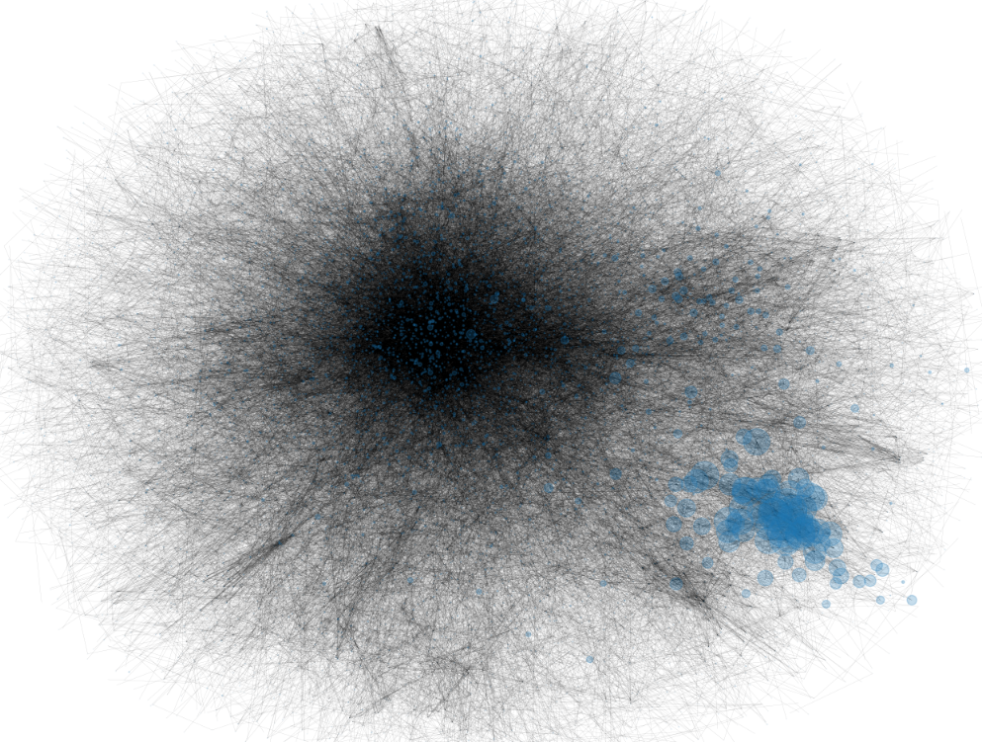
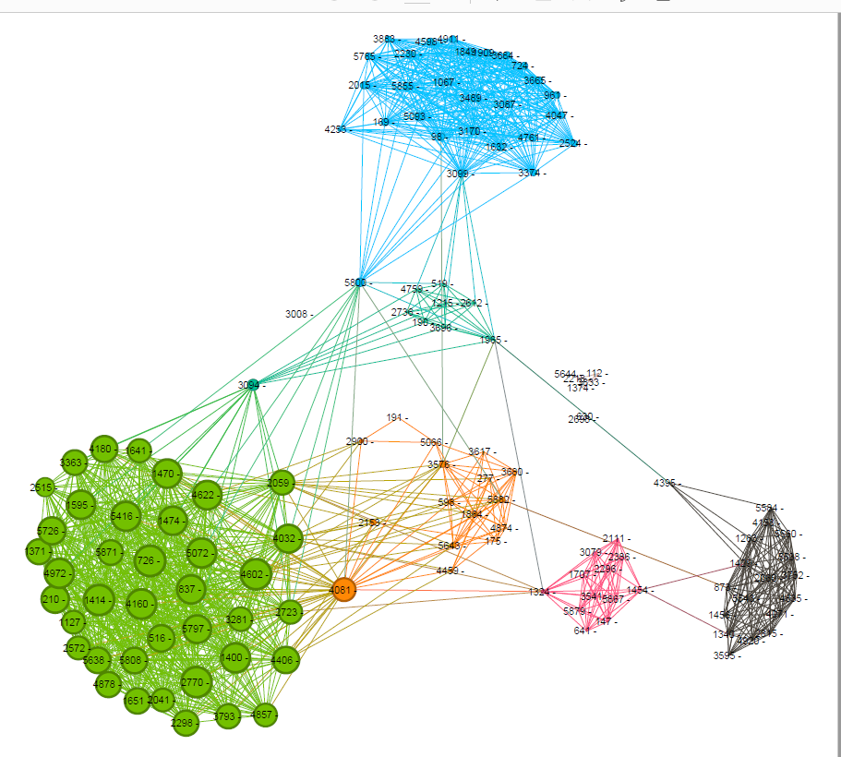
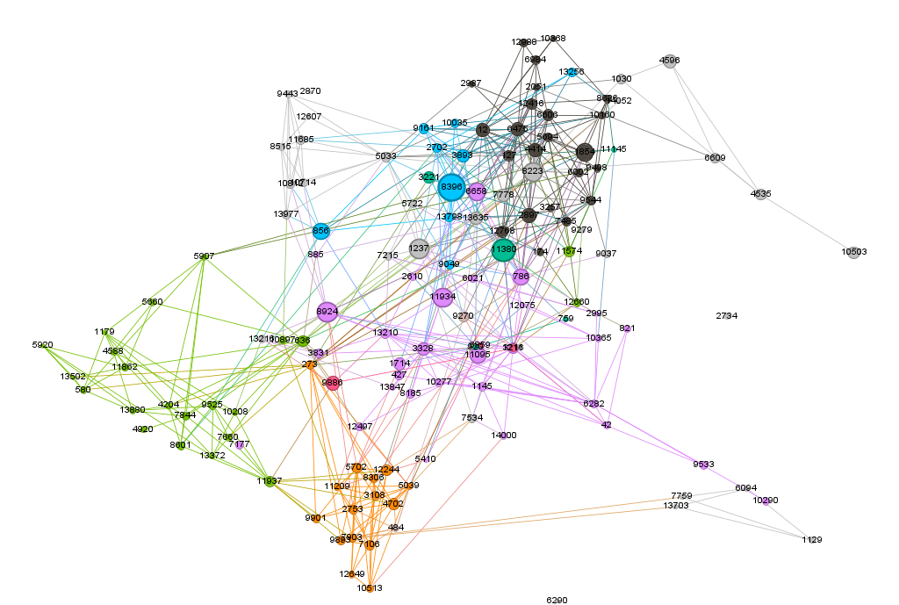
Using Python library Networkx and Gephi to Compare Facebook Networks
Politician Network
Company network

Slide 9
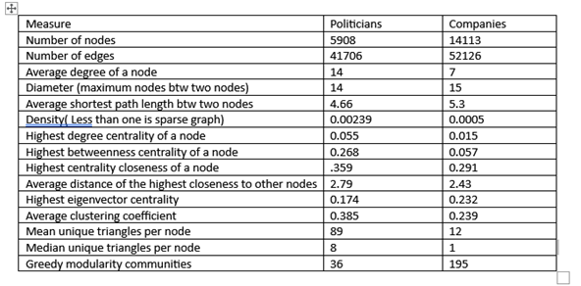

Slide 10
Results and Conclusions
Conclusions:
I. The retweeters of Walz are slightly less likely to be bots as Jensen retweeters.
II. Two social media networks can be compared using Networkx and Gephi. In the Facebook data analyzed, politicians had a more dense and clustered network than companies.
Things to Think About Going Forward:
I. Ways of generating a bigger sample size.
II. Further analysis of individuals to develop a more complete threshold of what constitutes a ‘bot’.
III. Explorations of ways of handling large edge lists, from initial visualizing to faster algorithm programs.
IV Exploration of scraping methods for Twitter data.

Slide 11
Resources
Stakeholders: https://twitter.com/GovTimWalz , https://twitter.com/drscottjensen
Networkx: https://networkx.org/nx-guides/content/exploratory_notebooks/facebook_notebook.html
Gephi Tutorial: https://www.slideshare.net/gephi/gephi-quick-start?from=ss_embed
Botometer paper: https://link.springer.com/article/10.1007/s42001-022-00177-5

